Slide 1



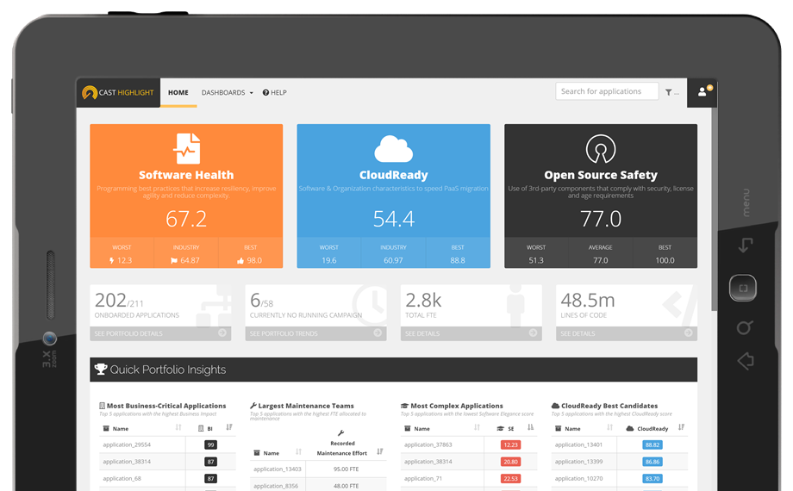
CAST Highlight METRICS & METHODOLOGY

Slide 2

Risk Acceptance Model & Indicators
Software Health and Risk-Acceptance model
Business Impact
Cloud Readiness
Open Source Safety
Software Maintenance Estimates
Technical Debt Estimates
ROAR Index
Back-Fired Function Points (BFP)

Slide 3
Risk Acceptance Model & Indicators
Model Purpose & Structure
Health Factors
Software Resiliency
Programming Best Practices
Secure/Dangerous Code
Software Agility
Code Readability
Embedded Documentation
Software Elegance
Computation Steps

Slide 4
Model Purpose
Fast code-level software health assessment
Complementary to long & deep code analysis
Identification of suspect programming defects
Decreasing software health at portfolio-level
Increasing technical risks
Short, mid and long-term impacts
File-based health/risk assessment and scoring
Capability to spot small pieces of potential critical defects, even in large applications
Model settings are defined for each covered technology, calibrations based on the assessment of +1,800 real applications across different customers & industries.

Slide 5
Model Structure
Health Factor
Quality Alarm
Code Insight
Trigger & Threshold
Code Patterns

Slide 6
Model Structure
Example
Health Factor – Software Resiliency
Quality Alarm – Best Practices
Code Insight – Avoid too many GROUP BY in queries
Trigger – Threshold defined by count on a
Code Pattern defined by:
Total SQL queries found in code
Total number of GROUP BY

Slide 7
Model Computation Steps
Health Factor
An alarm is the intermediate (not visible to end users) aggregation level of the underlying code insight scores.
A health factor is the aggregation of the underlying quality alarm scores.
Highlight Health Factor Calibration
Based on thousands applications we analyzed and benchmarked, we calibrate thresholds that will trigger a code insight, based on the defect volume we statistically observed.
Quality Alarms
Highlight analyzers scan the source files and count code patterns such as database queries, logical conditions, commented-out lines, etc.
Code Insights
Highlight Code Insight Calibration
Code Counters

Slide 8
Software Health
Software Health indicated how your application complies with programming best practices that increase resiliency, improve agility and reduce complexity. Software Health score is the straight average of Software Resiliency, Software Agility and Software Elegance scores.
(Software Resiliency + Software Agility + Software Elegance)
___________________________________________________
3

Slide 9

Software Resiliency
Software Resiliency indicates programming best practices that make software bullet-proof, more robust and secure. This index is derived through technology-specific code analysis that searches for the presence of code patterns that may comprise the reliability of the software at short term. Higher is the Software Resiliency, lower is the likelihood of defects occurring in production.
Quality Alarms
Code Reliability
Programming Best Practices
= (CodeReliabilityScore + ProgBestPracticesScore) / 2
^{Code Reliability}
^{Programming} ^{Best Practices}
(weight of 50%)
(weight of 50%)

Slide 10
Software Resiliency
Software Resiliency indicates programming best practices that make software bullet-proof, more robust and secure. This index is derived through technology-specific code analysis that searches for the presence of code patterns that may comprise the reliability of the software at short term. Higher is the Software Resiliency, lower is the likelihood of defects occurring in production.
Code Insights samples that impact the Software Resiliency
Java “Code Reliability” Code Insights
Too many assignment in conditional expression
Too many switch cases with missing ending break
Too many bug patterns
Too many calls to risky functions (eg: System.gc)
Out of Finally Jumps
Too many illegal throws (eg: java.lang.Error)
Missing Hash Code
Overload Equals
Too many control flow structure without braces
Class Comparisons (eg: use of getClass().getName())
^{Code Reliability}

Slide 11
Software Resiliency
Software Resiliency indicates programming best practices that make software bullet-proof, more robust and secure. This index is derived through technology-specific code analysis that searches for the presence of code patterns that may comprise the reliability of the software at short term. Higher is the Software Resiliency, lower is the likelihood of defects occurring in production.
Code Insights samples that impact the Software Resiliency
PHP “Programming Best Practices” Code Insights
Too many empty catches
Too many requests on too many tables or using "order by" clause
Too many objects not assigned to a variable once instantiated, or contains too many assignments to "this“
Too many concatenations of literal string having the same type (simple or double quote) or contains too many lonely variables in string
Too many functions whose parameters having a default value don't come at the end of the function signature
^{Best Practices}

Slide 12
Software Resiliency
Software Resiliency indicates programming best practices that make software bullet-proof, more robust and secure. This index is derived through technology-specific code analysis that searches for the presence of code patterns that may comprise the reliability of the software at short term. Higher is the Software Resiliency, lower is the likelihood of defects occurring in production.
Code Insights samples that impact the Software Resiliency
PHP “Programming Best Practices” Code Insights
Too many unconditional "if" or "elseif" instructions whose conditions expression are the hardcoded "true" or "false" values
Too many final artifacts in final classes
Too many empty statement blocs (containing no instructions)
Too many conditions with missing identical operator
Too many classes that declare __get() without declaring __set()
Too many "for" loops that could be simplified to a "while" loop, or contains too many loops having functions calls in their end tests
^{Best Practices}

Slide 13

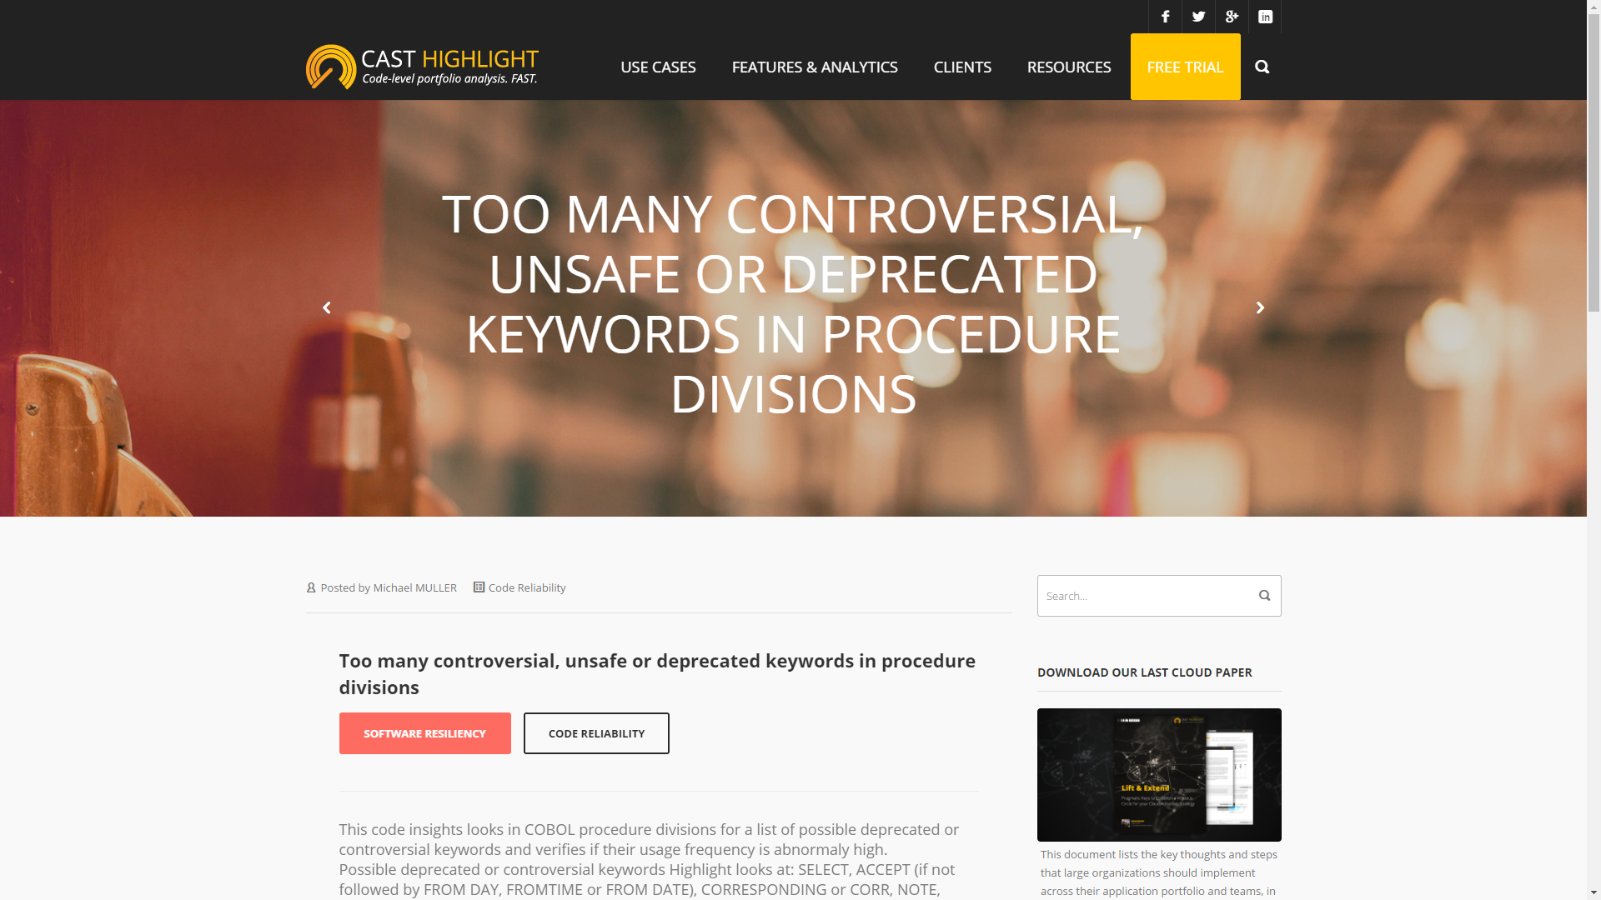

Software Resiliency
Software Resiliency indicates programming best practices that make software bullet-proof, more robust and secure. This index is derived through technology-specific code analysis that searches for the presence of code patterns that may comprise the reliability of the software at short term. Higher is the Software Resiliency, lower is the likelihood of defects occurring in production.

Slide 14
Software Agility
Software Agility indicates the easiness of a development team to understand and maintain an application. This index is derived through technology-specific code analysis that searches for the presence of embedded documentation and code readability good practices.
Quality Alarms
Embedded documentation
Code Readability
= (ReadabilityScore + EmbDocumentationScore) / 2
^{Embedded documentation}
^{Code Readability}
(weight of 50%)
(weight of 50%)

Slide 15
Software Agility
Software Agility indicates the easiness of a development team to understand and maintain an application. This index is derived through technology-specific code analysis that searches for the presence of embedded documentation and code readability good practices.
Code Insights samples that impact the Software Agility
PHP “Embedded Documentation” Code Insights
The file has a low comment rate ratio
The file contains suspicious code comments (eg: TBD, to do…)
Too many functions, interfaces or classes with closing not commented
Too many functions throwing exceptions that have inconsistencies in @throw tags
^{Embedded documentation}

Slide 16
Software Agility
Software Agility indicates the easiness of a development team to understand and maintain an application. This index is derived through technology-specific code analysis that searches for the presence of embedded documentation and code readability good practices.
Code Insights samples that impact the Software Agility
PHP “Code Readability” Code Insights
Heterogeneous encoding (too many different line & space format, or character encoding)
Too many long lines
Too many elseif statements
Too many deprecated constructor naming (should be __construct)
Too many files that don’t respect naming conventions
Too many classes that don’t respect naming conventions
Too many functions that don’t respect naming conventions
Too many classes whose name is different from the file name
Too many unused parameters in functions
^{Code Readability}

Slide 17
Software Agility
Software Agility indicates the easiness of a development team to understand and maintain an application. This index is derived through technology-specific code analysis that searches for the presence of embedded documentation and code readability good practices.
Code Insights samples that impact the Software Agility
PHP “Code Readability” Code Insights
Too many uppercase control structure keywords
Too many useless overriding methods that only call their parent classes' method with the same name and arguments
Too many increment/decrement operators
^{Code Readability}

Slide 18
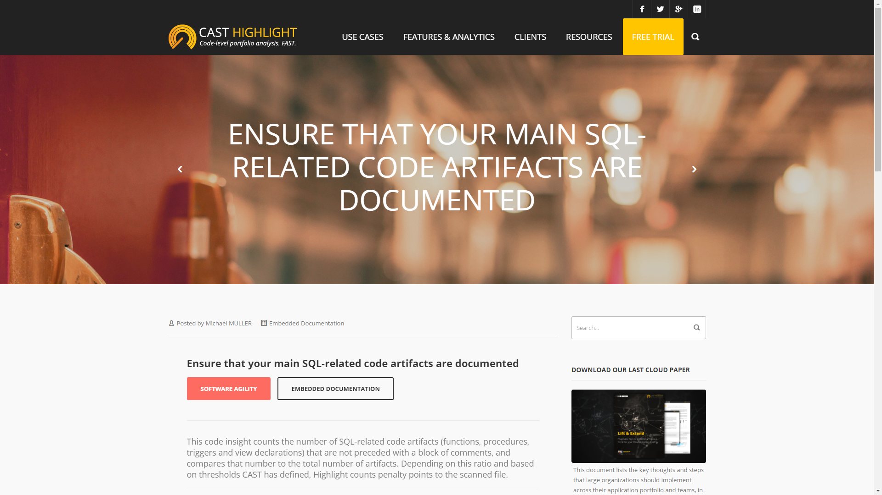
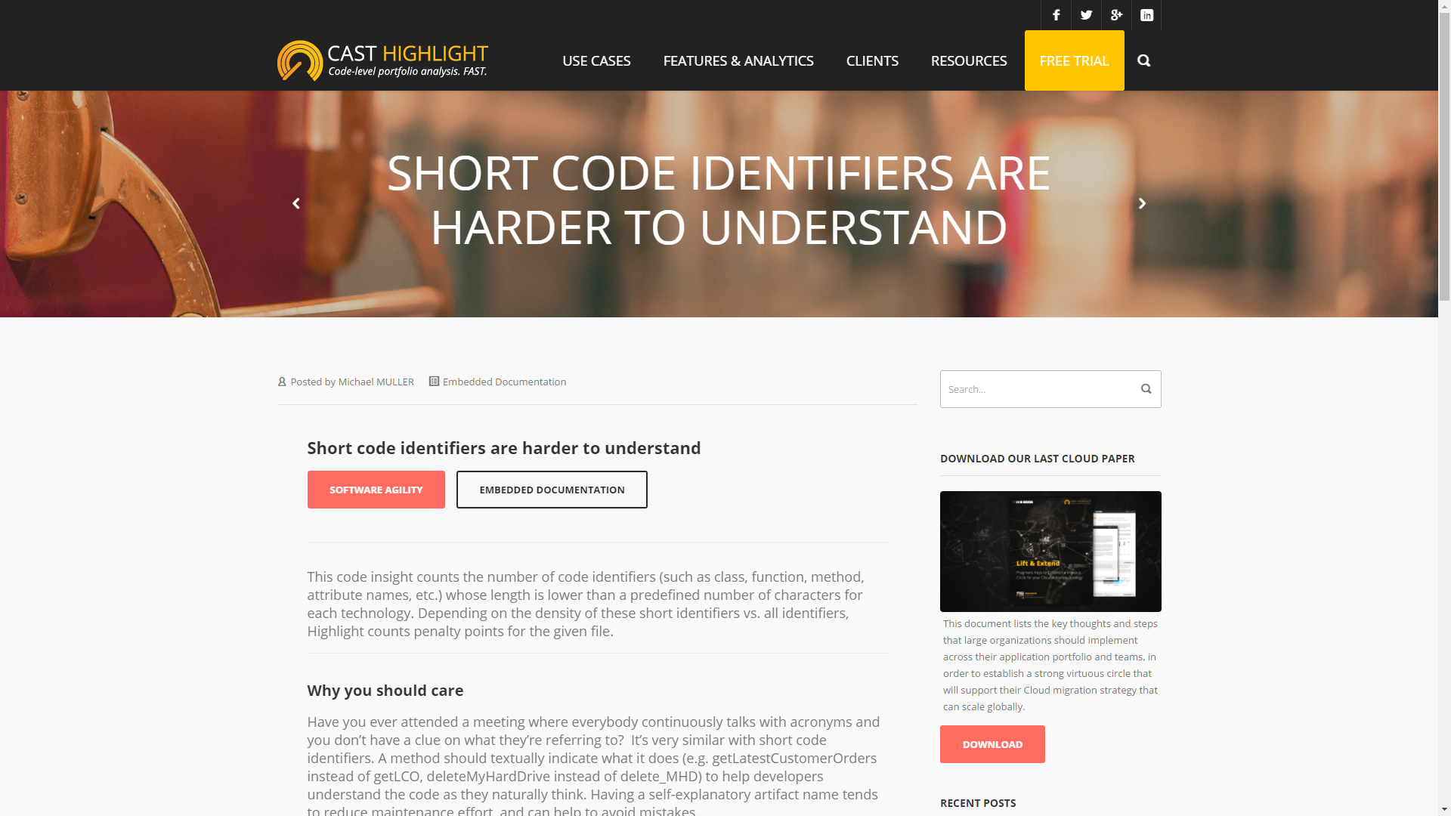

Software Agility
Software Agility indicates the easiness of a development team to understand and maintain an application. This index is derived through technology-specific code analysis that searches for the presence of embedded documentation and code readability good practices.

Slide 19
Software Elegance
Software Elegance measures the ability to deliver software value with less code complexity. A low Software Elegance score indicates decreased quality in the code resulting in higher defects that become costly to fix at mid-term.
Eg: Abap “Software Elegance” Code Insights
The file contains too many lines of code
The code has a too high Cyclomatic Complexity
Too many code artifacts (e.g. functions, procedures, modules, methods…)
Too many artifacts with a high level of nested control structures
The file contains too many includes
The code contains too many “SELECT *” queries

Slide 20
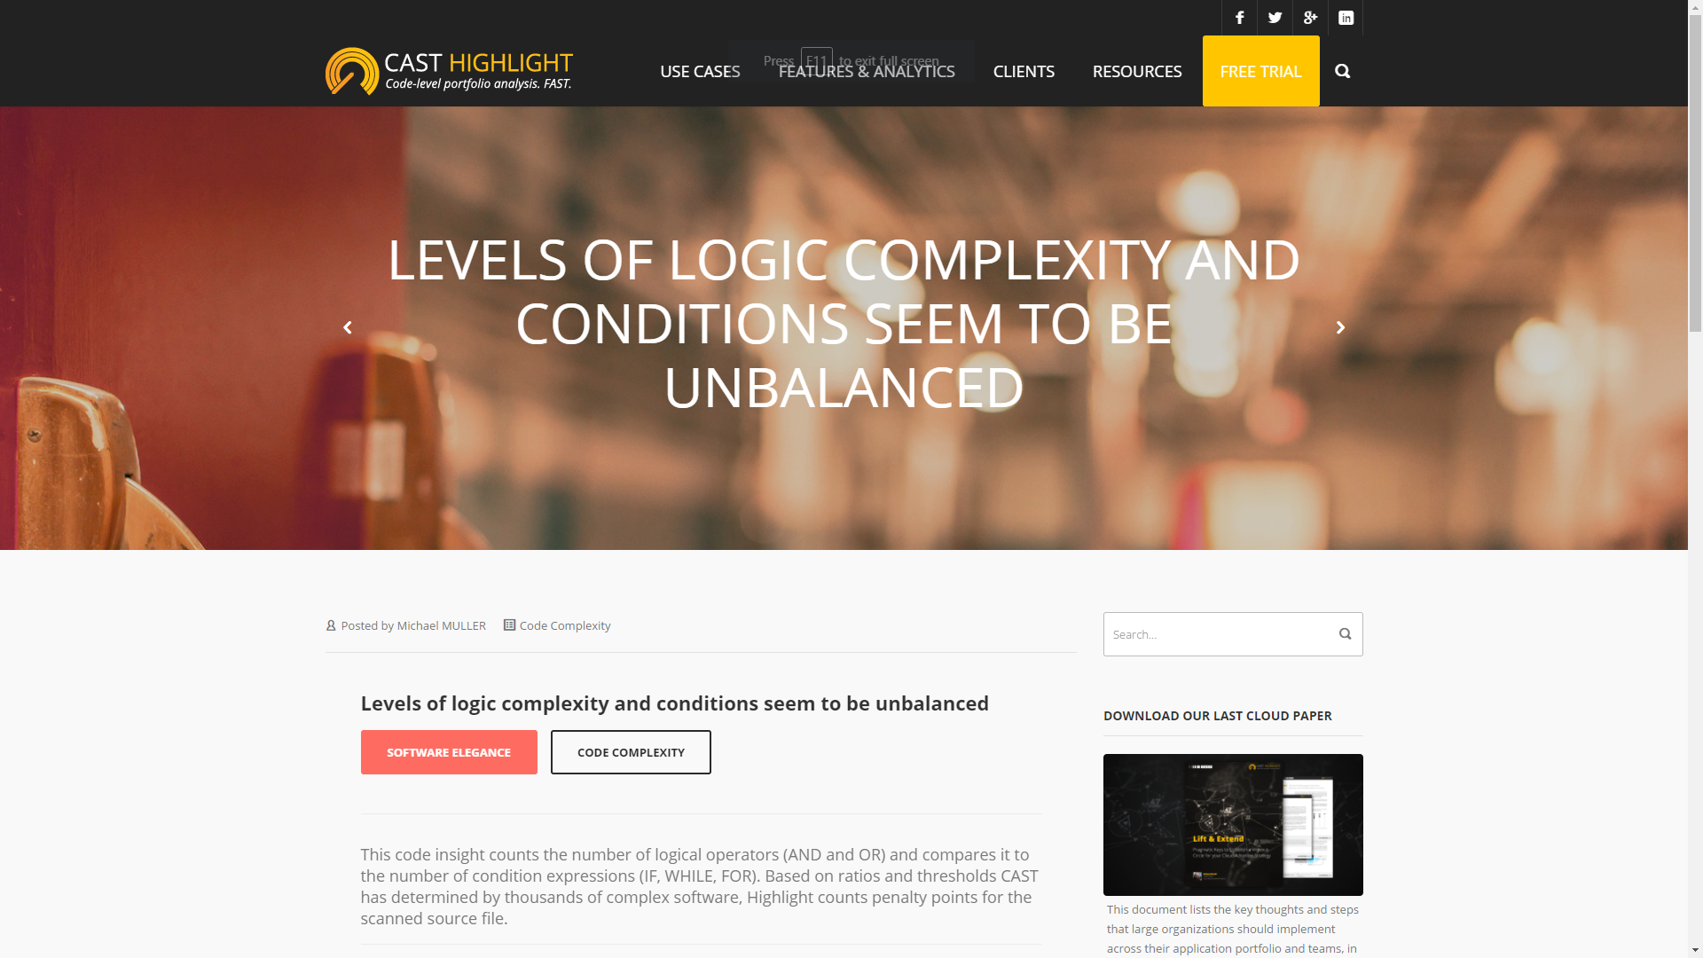
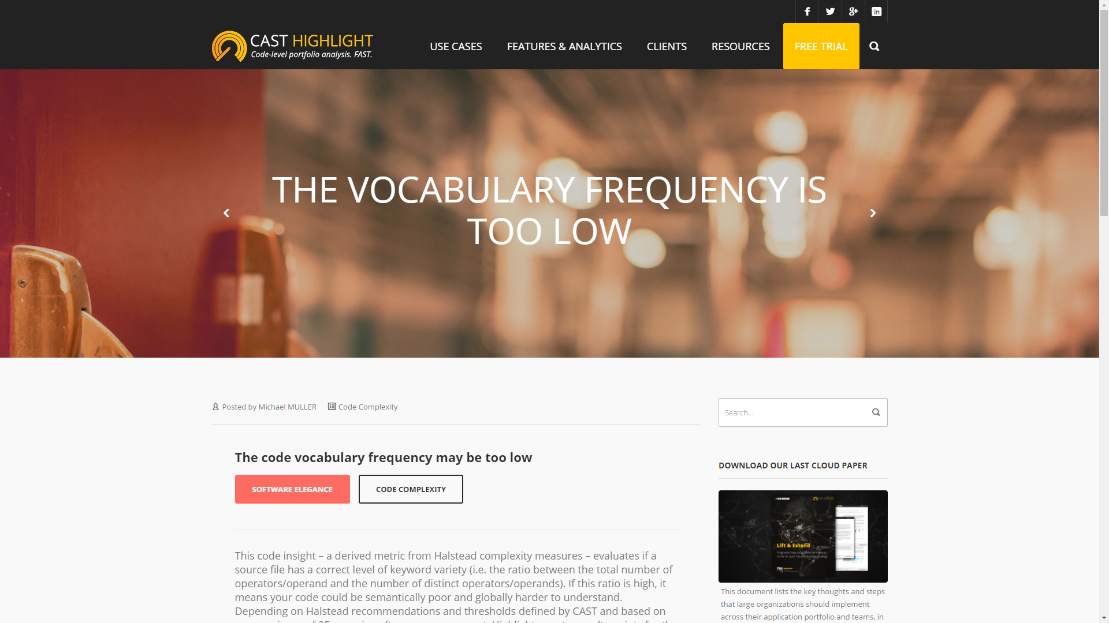

Software Elegance
Software Elegance measures the ability to deliver software value with less code complexity. A low Software Elegance score indicates decreased quality in the code resulting in higher defects that become costly to fix at mid-term.

Slide 21
Model Computation Steps
1
Code Scan at File-Level
Count for:
Total Database Queries
Queries with ‘GROUP BY’ clause
Example for a PHP file:
12 database queries
2 queries with ‘GROUP BY’ clause

Slide 22
Model Computation Steps
2
Code Insight Computation at File-Level
Example with “SQL” Code Insight:
SQL = 100 x (GroupByQueries) / Total Queries
SQL = 100 x (2) / 12
SQL = 16.6

Slide 23
Model Computation Steps
3
Code Insight Contribution to Alarms at File-Level
Code Insight Penalty Points Computation:
SQL Penalty point calculation for the scanned file:
If SQL > 80.00 => 12 penalty points
If SQL > 50.00 => 8 penalty points
If SQL > 20.00 => 4 penalty points
If SQL > 0.00 => 2 penalty points
In our example, the GROUP BY code insight was 16.6.
Highlight counts 2 penalty points for the current file, contributing to the “Best Practices” quality alarm that belongs to the Software Resiliency computation.
Penalty Points are specific for each Code Insight, depending on the nature/criticality of the insight.

Slide 24
Model Computation Steps
4
Quality Alarm Computation at File-Level
Best Practices Quality Alarm Computation:
Alarm = (20 - Sum(CodeInsights)) / 20
In our example:
Best Practices = (20 – 2) / 20
Best Practices = 0.9 (out of 1)
Maximum score for an alarm. This value depends on technology.
Sum of Penalty Points for each code insight

Slide 25
Model Computation Steps
5
Quality Alarm Aggregation at Technology-Level
TechnologyAlarm = Average(FileAlarm)

Slide 26
Model Computation Steps
6
Quality Alarm aggregation at Technology-Level
Average of quality alarms for
Software Resiliency
Software Agility
Quality Alarm for Software Elegance

Slide 27
Model Computation Steps
7
Indicator aggregation at Application-Level
Weighted Average (by Lines of Code) of Health Factors for all technologies of an application
Application – Software Resiliency = 60.7
((66x500) + (8x50)) / (500+50) = (33000+ 400) / 550
Java – Software Resiliency = 66 500 KLOC
PL/SQL Software Resiliency = 8 50 KLOC
This mechanism allows portfolio managers to easily detect applications that may have small BUT dangerous portion of code, even in a large code base.

Slide 28
Model Computation Steps
8
Software Health Categorization
3 level of health depending on value thresholds
High Quality
Medium Quality
Low Quality
Categorization available at File and Application levels
Health factors, quality alarm and code insights thresholds are regularly refined by Highlight, in order to provide users with the most accurate insight on their software strengths & risks.

Slide 29
Model Computation Steps
8
Software Health Categorization
Software Resiliency
Software Agility
Software Elegance
High > 84.0
High > 71.0
High > 78.0
Medium > 62.0
Medium > 56.0
Medium > 55.0
Low < 62.0
Low < 56.0
Low < 55.0
Health factors, quality alarm and code insights thresholds are regularly refined by Highlight, in order to provide users with the most accurate insight on their software strengths & risks.

Slide 30
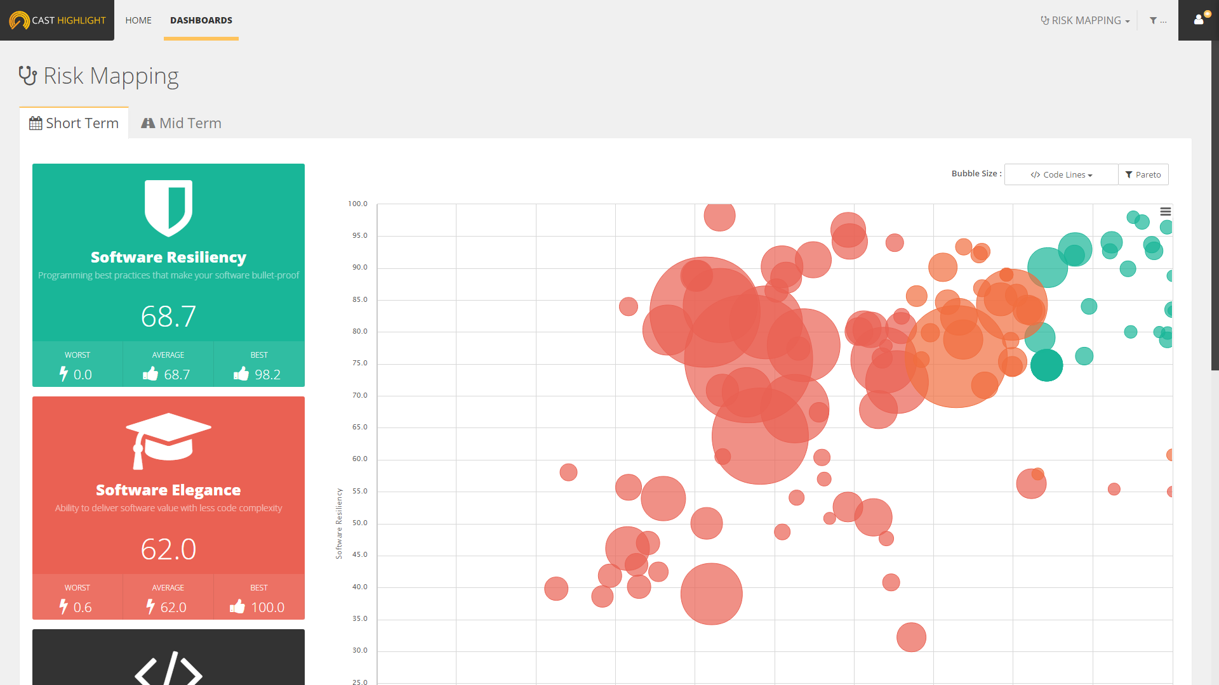
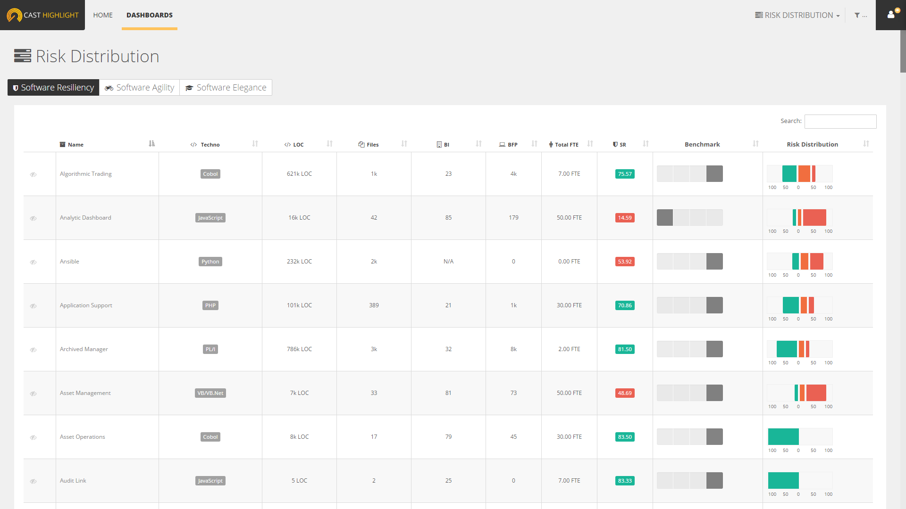
Model Computation Steps
8
Software Health Categorization
Health factors, quality alarm and code insights thresholds are regularly refined by Highlight, in order to provide users with the most accurate insight on their software strengths & risks.

Slide 31
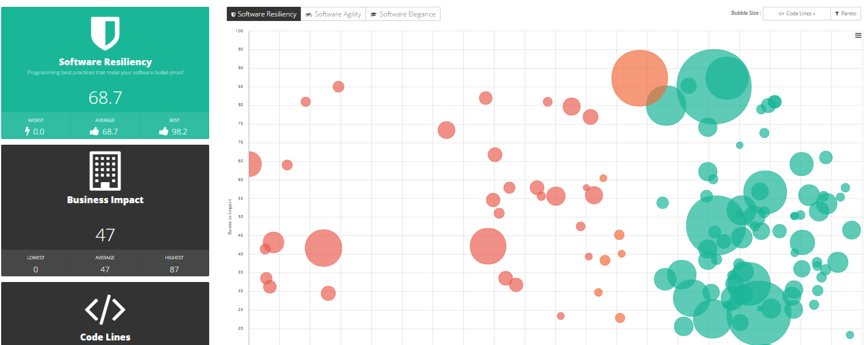
Business Impact
Business Impact measures the criticality and importance of an application to your company’s business

Slide 32
Business Impact
Business Impact is defined for each application
Based on the 9 collected answers from the Business Impact survey
Each answer contributes differently (weightings)
Business Value is scaled from 0 to 100
Weighting model is defined by Highlight
Top drivers for Business Impact
Average number of end-users
Average number of people who worked on code
Number of application releases over the year
Application exposure (external, internal or both)
Criteria and weights can be customized at the portfolio level

Slide 33
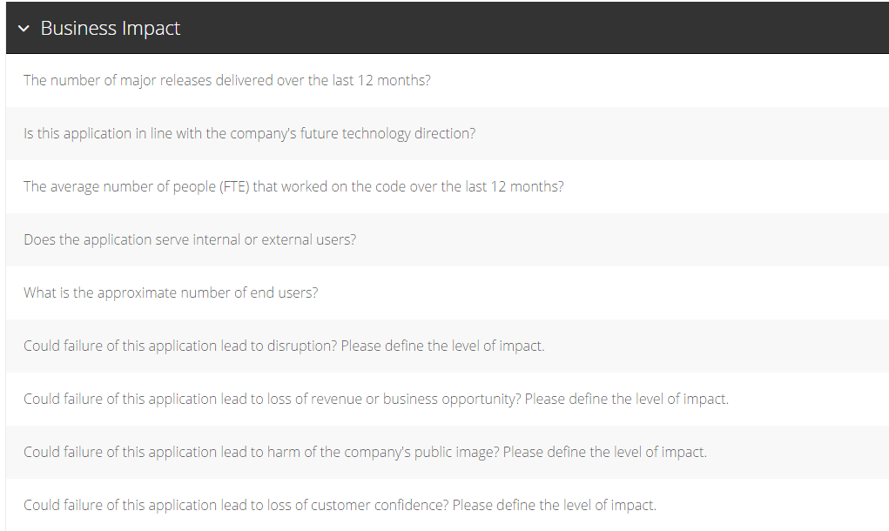
Business Impact

Slide 34
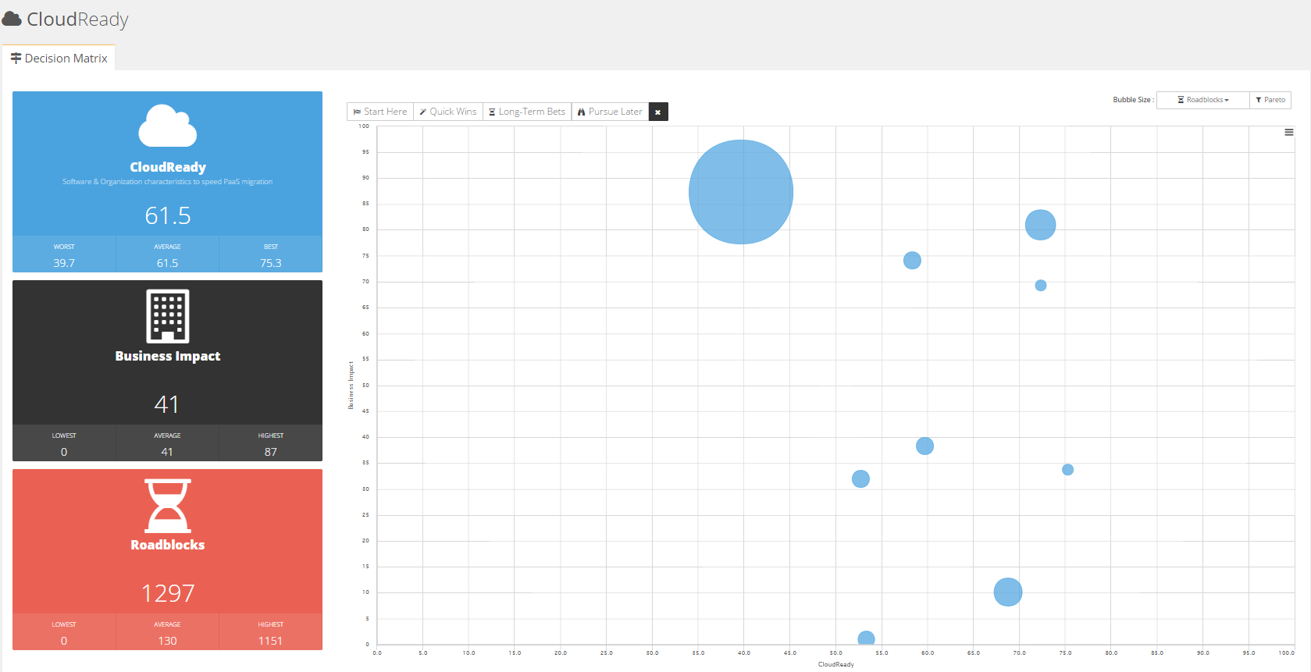
CloudReady
CloudReady Index measures the readiness of your applications to migrate to the Cloud based on software blockers and the organizational context of an application.

Slide 35
CloudReady
CloudReady 45.2
Based on CloudReady Survey
Based on CloudReady Scan
13.4
77.1
(weight of 50%)
(weight of 50%)
Code Patterns Score
50+ Code Patterns
Targeted to coding language (Java, C#, VB.Net)
Positive (Boosters) or Negative (Blockers) contribution
Criticality level (critical, high, medium, low)
Impact area (code, framework, architecture of the application)
5.6
5.0
Boosters
Blockers
Based on Positive Code Patterns
(weight of 10%)
Based on Negative Code Patterns
(weight of 40%)

Slide 36
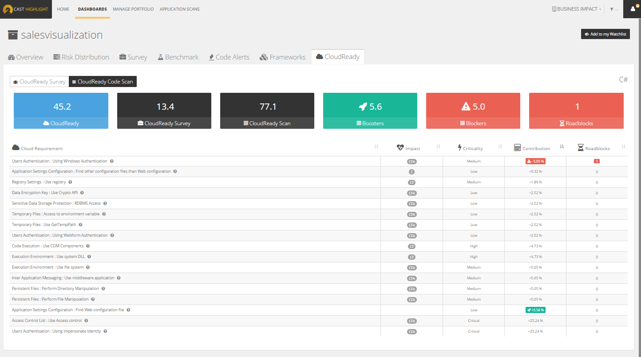
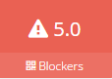
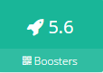
CloudReady Index formula – example 1
CloudReady 45.2
(weight of 50%)
(weight of 50%)
CloudReady Survey
CloudReady Scan
13.4
77.1
[ (100 - )*0.80 ]
+
[ *0.20 ]

Slide 37
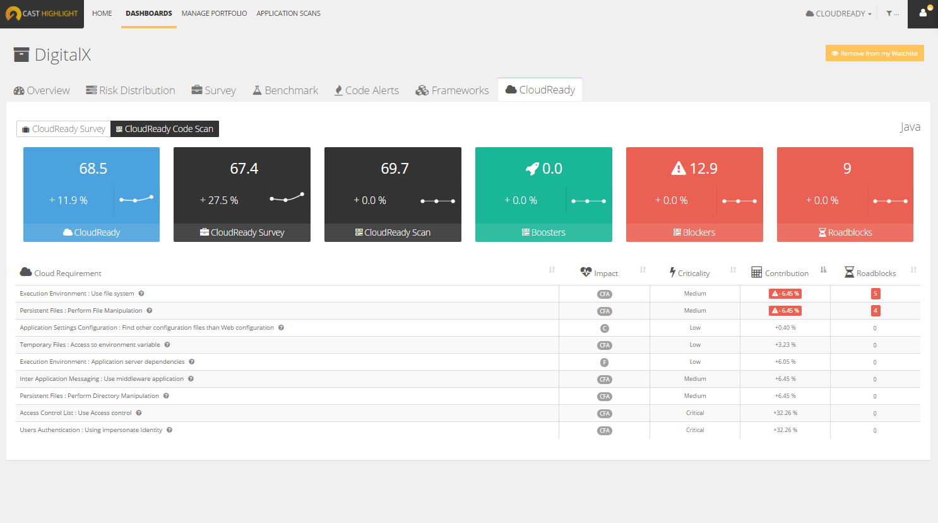
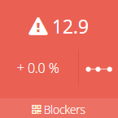
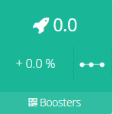
CloudReady Index formula – example 2
CloudReady 68.5
(weight of 50%)
(weight of 50%)
CloudReady Survey
CloudReady Scan
67.4
69.7
[ (100 - )*0.80 ]
+
[ *0.20 ]

Slide 38
CloudReady
Access Control List
Persistent Files
Application Logs
Registry Settings
Application Settings Configuration
Sensitive Data Storage Protection
Code Execution
Service & Schedule Tasks
Data Encryption Keys
Shared Caching
OS and Environment Dependencies
Temporary Files
Inter-Application Messaging
Third-Party External Dependencies
User Authentication
200+ Code Patterns
Targeted to coding language (Java, C#, VB.Net)
Positive (Boosters) or Negative (Blockers) contribution to Cloud Ready Index
Criticality level (critical, high, medium, low)
Impact area (code, framework, architecture of the application)

Slide 39
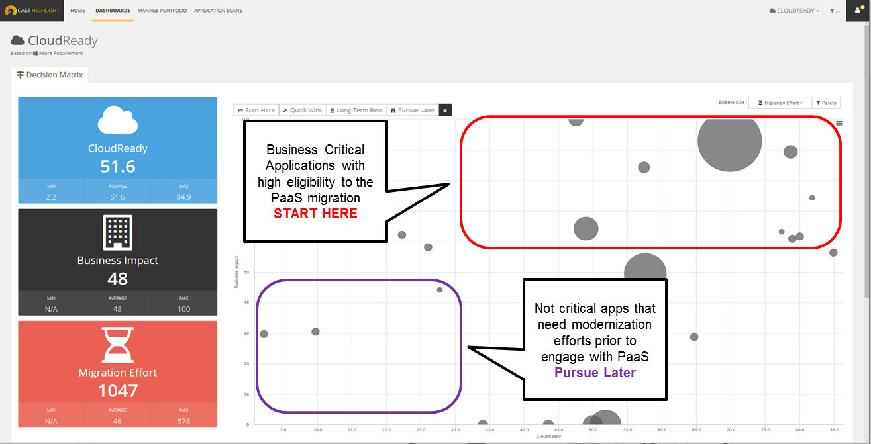
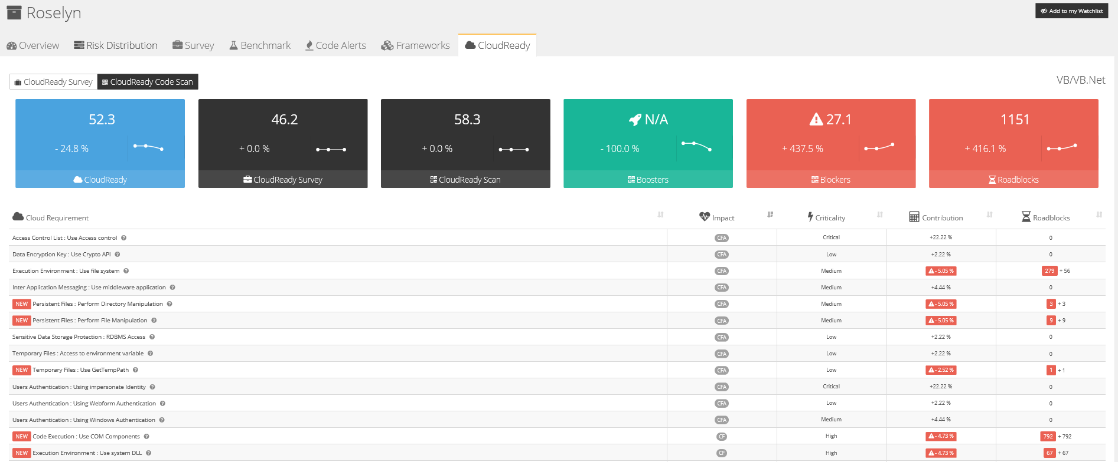
CloudReady – Survey Results
1
Understand who the best candidates for PaaS are ….
2
Click on the application to see technical roadblocks

Slide 40
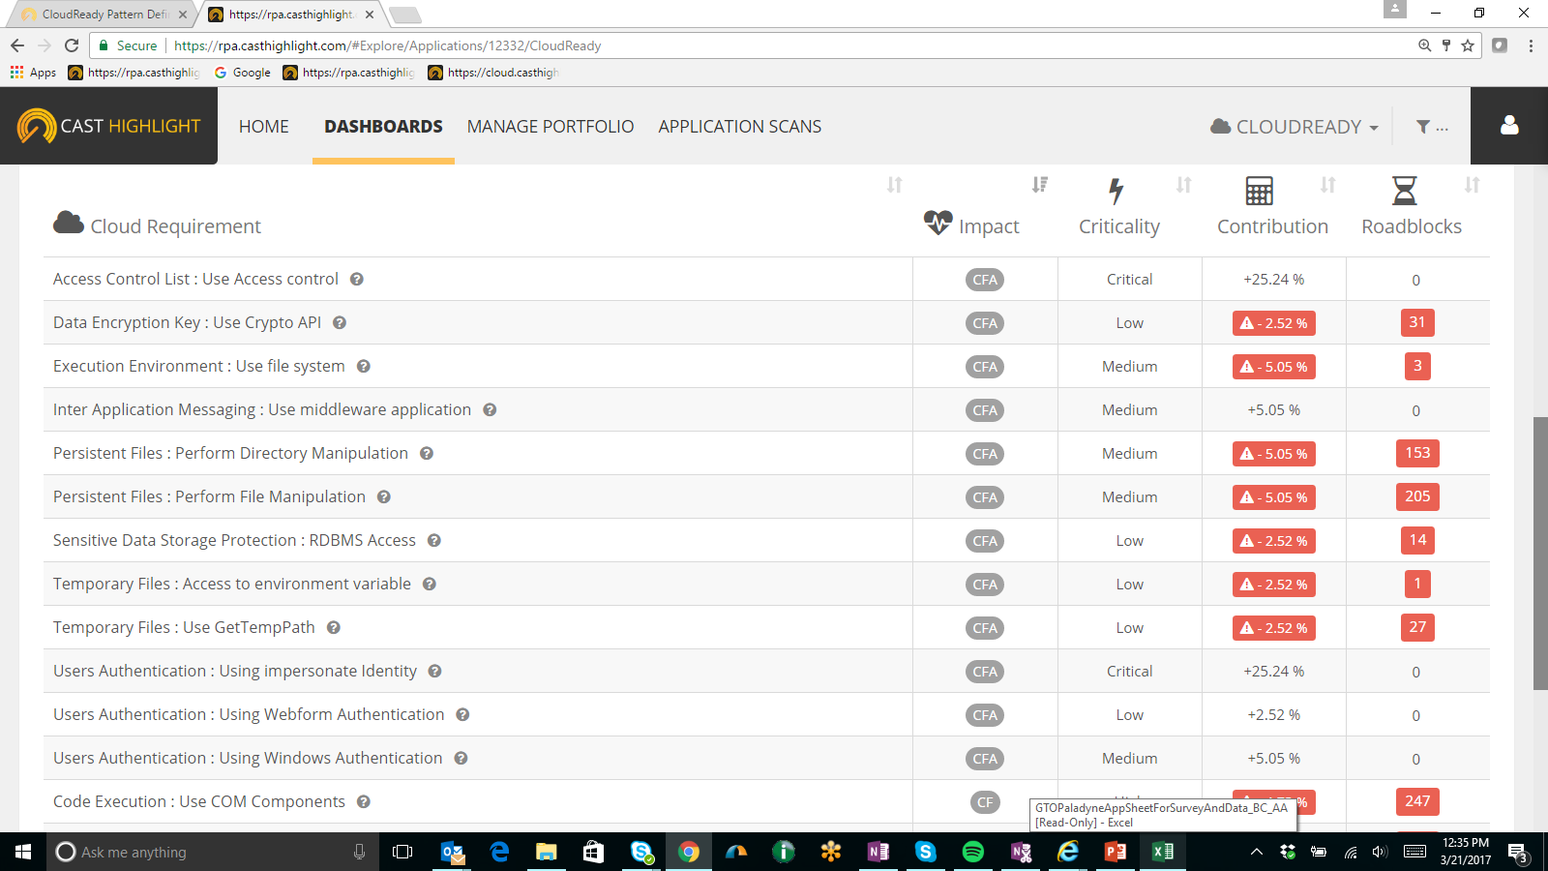
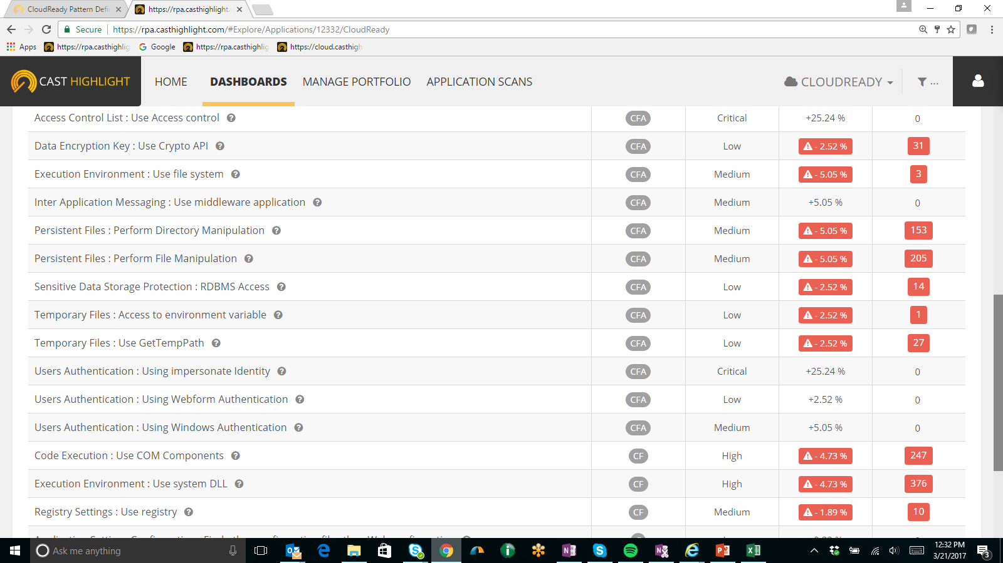
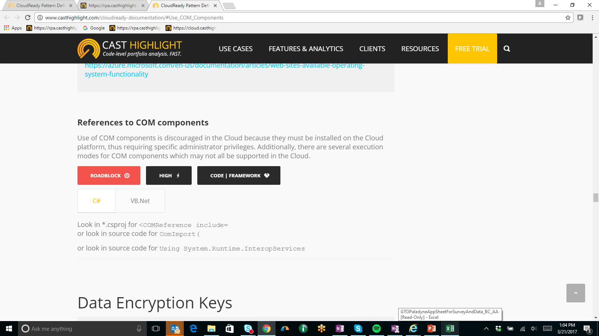
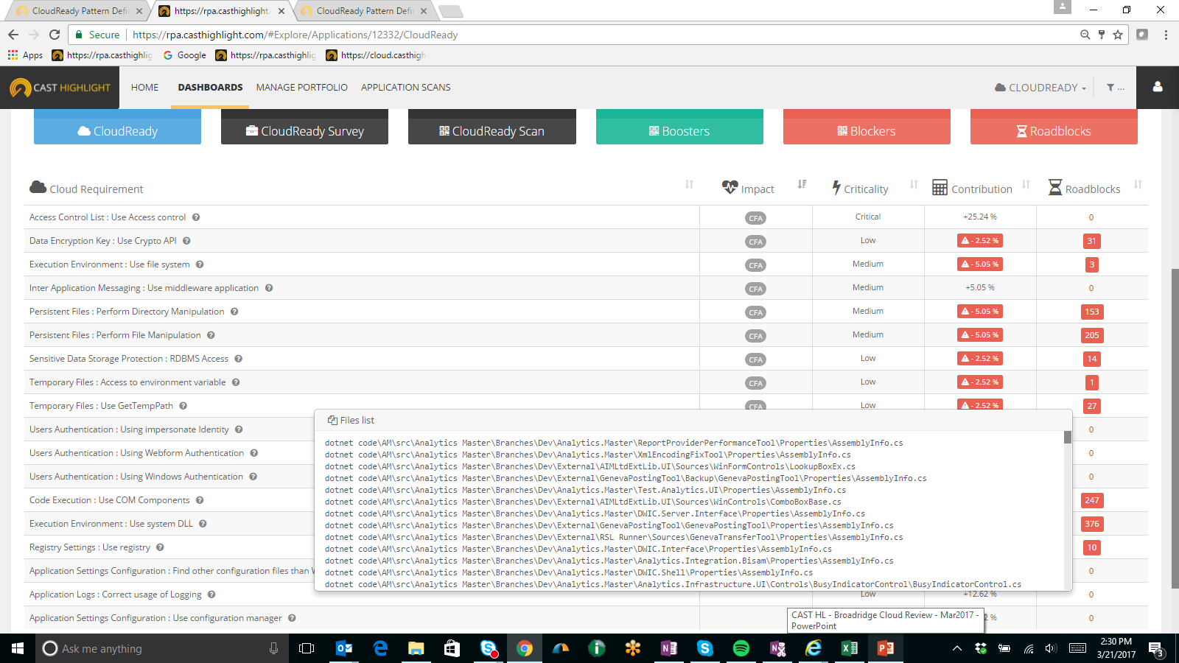
CloudReady – Pattern examples
Identified Tasks For Code Execution
Validate the application privileges prerequisites
Replace unsupported components with in-process equivalent and supported libraries.

Slide 41
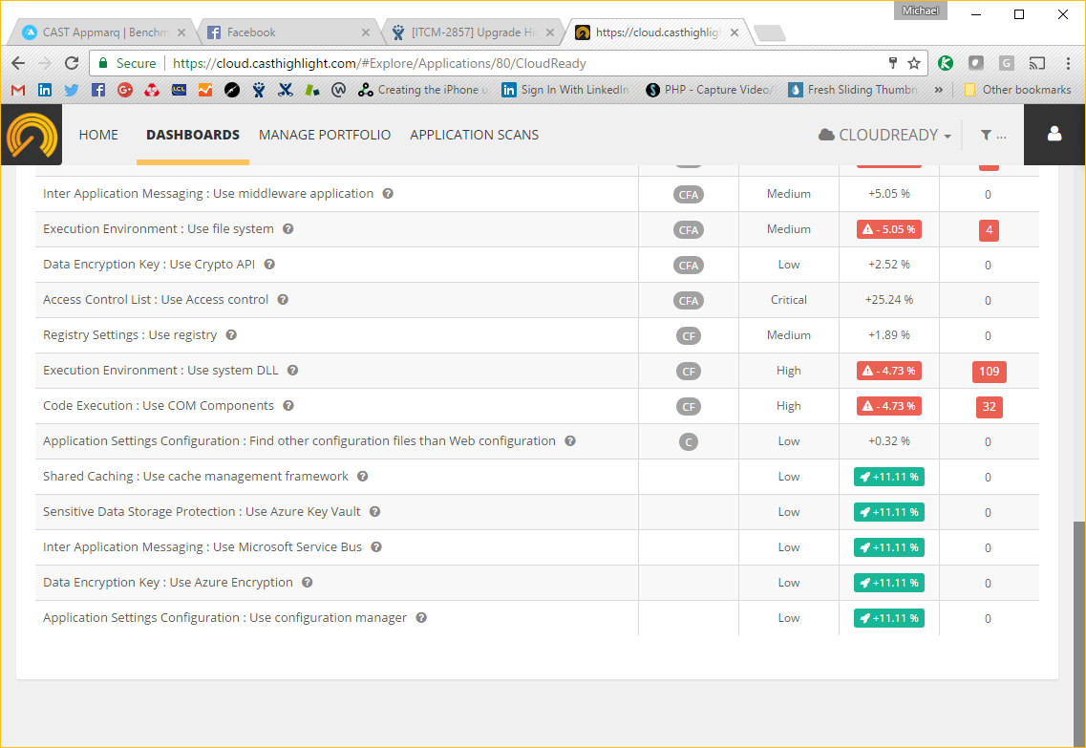
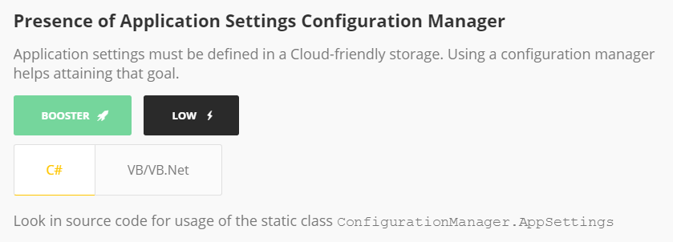
CloudReady – Pattern examples
Identified Tasks For Application Settings Configuration
Implement “access to the settings” methods from the environment variables if the web platform is not .NET

Slide 42
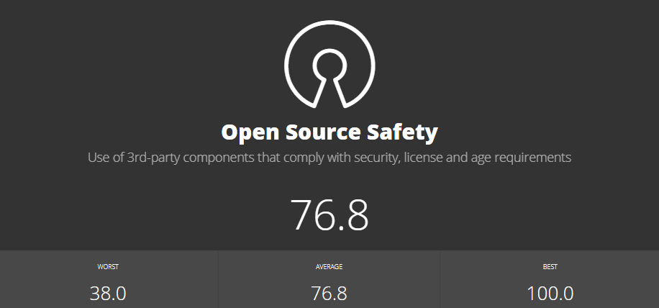
Open Source Safety
Open Source Safety indicates the use of 3rd-party components that comply
with security, license and age requirements.

Slide 43
Open Source Safety
This index from 0 (low safety) to 100 (high safety) is an average of the three underlying scores for measuring Open Source/Third-Party component risk. It is calculated at an application level and then rolled up for the entire portfolio (straight average of all application scores). The three underlying scores are summarized below, and the detailed formulas are on the subsequent pages:
Security Risk: This score from 0 (low security) to 100 (high security) is calculated based on the number of open source/third-party components in an application and the total number of Common Vulnerabilities & Exposures (CVEs), weighted by CVE criticality (critical, high, medium and low).
License Risk: This score from 0 (high risk) to 100 (low risk) is calculated based on the number of components having a low risk license, the number of components having a medium risk license, and the number of components having a high-risk license, where low/medium/high risk license have different weights.
Obsolescence Risk: This score from 0 (high obsolescence) to 100 (low obsolescence) is calculated based on the gap between the current version of the components detected in applications and the latest known version of each corresponding component
*Additional components with partial information don’t contribute to Open Source Safety scores.

Slide 44
Open Source Safety – Security Risk Formula
Security Risk: This score from 0 (low security) to 100 (high security) is calculated based on the number of open source/third-party components in an application and the total number of Common Vulnerabilities & Exposures (CVEs), weighted by CVE criticality (critical, high, medium and low).
Calculation (at the application level):
5 or more Critical CVEs -> score = 0
1 – 4 Critical CVEs -> score is normalized from 16 (1 Critical CVE) to 4 (4 Critical CVEs)
0 Critical CVEs -> score = 100
10 or more High CVEs (and 0 critical CVEs) -> score = 0
1 – 9 High CVEs (and 0 critical CVEs) -> score is normalized from 54 (1 High CVE) to 6 (9 High CVEs)
0 High CVEs (and 0 critical CVEs) -> score = 100
10 or more Medium CVEs (and 0 Critical 0 High CVEs) -> score = 50/100
1 – 9 Medium CVEs (and 0 Critical 0 High CVEs) -> score is normalized from 86 (1 Medium CVE) to 46 (9 Medium CVEs)
0 Medium CVEs (and 0 Critical 0 High CVEs) -> score = 100
8 or more Low CVEs (and 0 Critical 0 High 0 Medium CVEs) -> score = 80
1 – 7 Low CVEs (and 0 Critical 0 High 0 Medium CVEs) -> score is normalized from 97.5 (1 Low CVE) to 82.5 (7 Low CVEs)
0 Low CVEs (and 0 Critical 0 High 0 Medium CVEs) -> score = 100

Slide 45
Open Source Safety – License Risk Formula
License Risk: This score from 0 (high risk) to 100 (low risk) is calculated based on the number of components having a low risk license, the number of components having a medium risk license, and the number of components having a high-risk license.
Calculation (at the application level):
Calculation is based on the license risk profile for each matched component as defined for the portfolio. Three possible values for license risk are: low / medium / high (undefined)
Qualification:
at least 1 component matched to CAST Highlight SCA database (frameworks not matched will be ignored)
at least 1 component with a defined license (undefined not evaluated)
Formula: (# of components with low risk * 1 + # of components with med risk * 0.5) / (# of components with low risk + # of components with med risk + # of components with high risk)
=> result between 0 (worst) 1 (best) and then normalized to 0 - 100

Slide 46
Open Source Safety – Obsolescence Risk Formula
Obsolescence Risk: This score from 0 (high obsolescence) to 100 (low obsolescence) is calculated based on the gap between the current version of the components detected in applications and the latest known version of each corresponding component.
Calculation (at the application level):
Calculation is based on the release date of the version of the component detected (releaseDate) and the release data of the latest know version of the corresponding component (lastReleaseDate).
Qualification:
at least 1 component matched to CAST Highlight SCA database (frameworks not matched will be ignored)
only components with a lastReleaseDate > releaseDate (i.e., unreleased components are ignored)
Formula at the component level: Maximum Gap of 100 months -> score = 0 Param1 = 1.66667 // internal parameter of the formula DiffMonth = min(100, Diff(lastReleaseDate, releaseDate) // difference between the detected version and the latest version DeprecationIndicator = 1 - Param1 * (-1(POWER(1 + DiffMonth, DiffMonth/1000)))
The application score is the straight average of all component scores (DeprecationIndicator)

Slide 47
ROAR Index
Definition The ROAR (Ranking Of Application Risks) index is a composite metric (from 0 to 100) that takes into account the three main Highlight health factors (Software Resiliency, Agility and Elegance) with a weighted average formula, balanced with the Business Impact of the application.
Formula ROAR = ((100 – SR) * 7) + ((100 – SE) * 2) + ((100 – SA) * 1) / 10 * BI
Score Interpretation
A high value means that the application is important to the business and presents a high level of risk (from a code quality standpoint) in the same time. Urgent to investigate.
A low value means that the application is not very important to the business and presents relatively acceptable level of code quality. Investigation is low priority.

Slide 48
Back-Fired Function Points
Back-Fired Function Point (BFP) estimates the number of function points of an application
This code-derived metric is based on the lines of code, weighted by an abacus for a given technology
The abacus is taken from QSM (Quantitative Software Management)
http://www.qsm.com/resources/function-point-languages-table

Slide 49
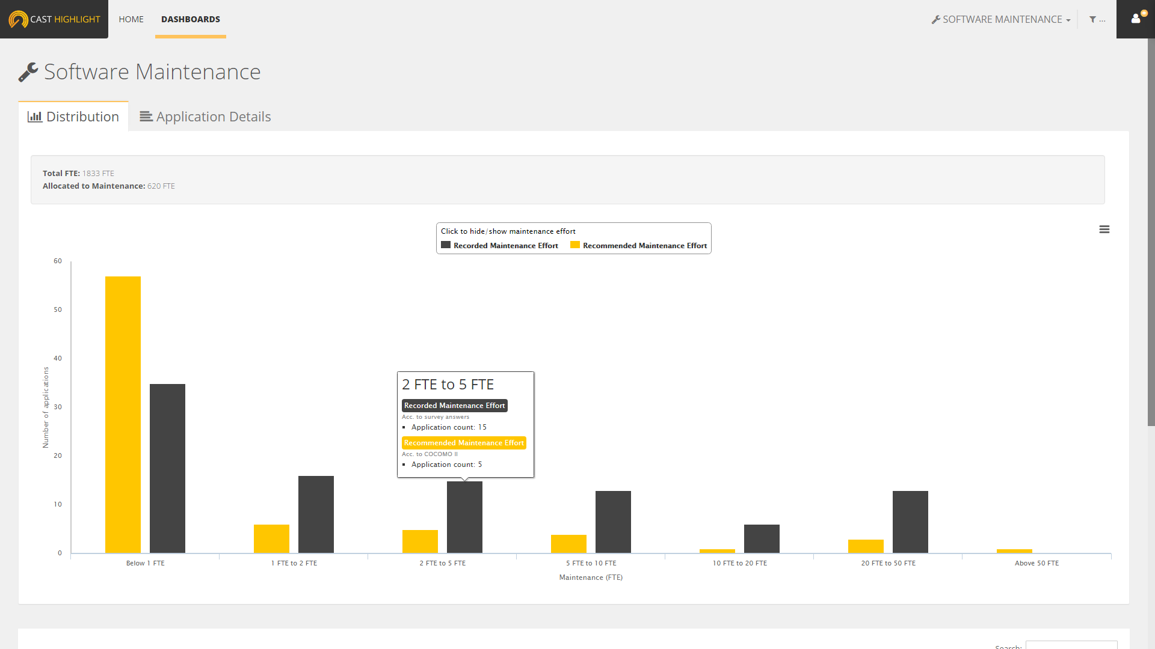
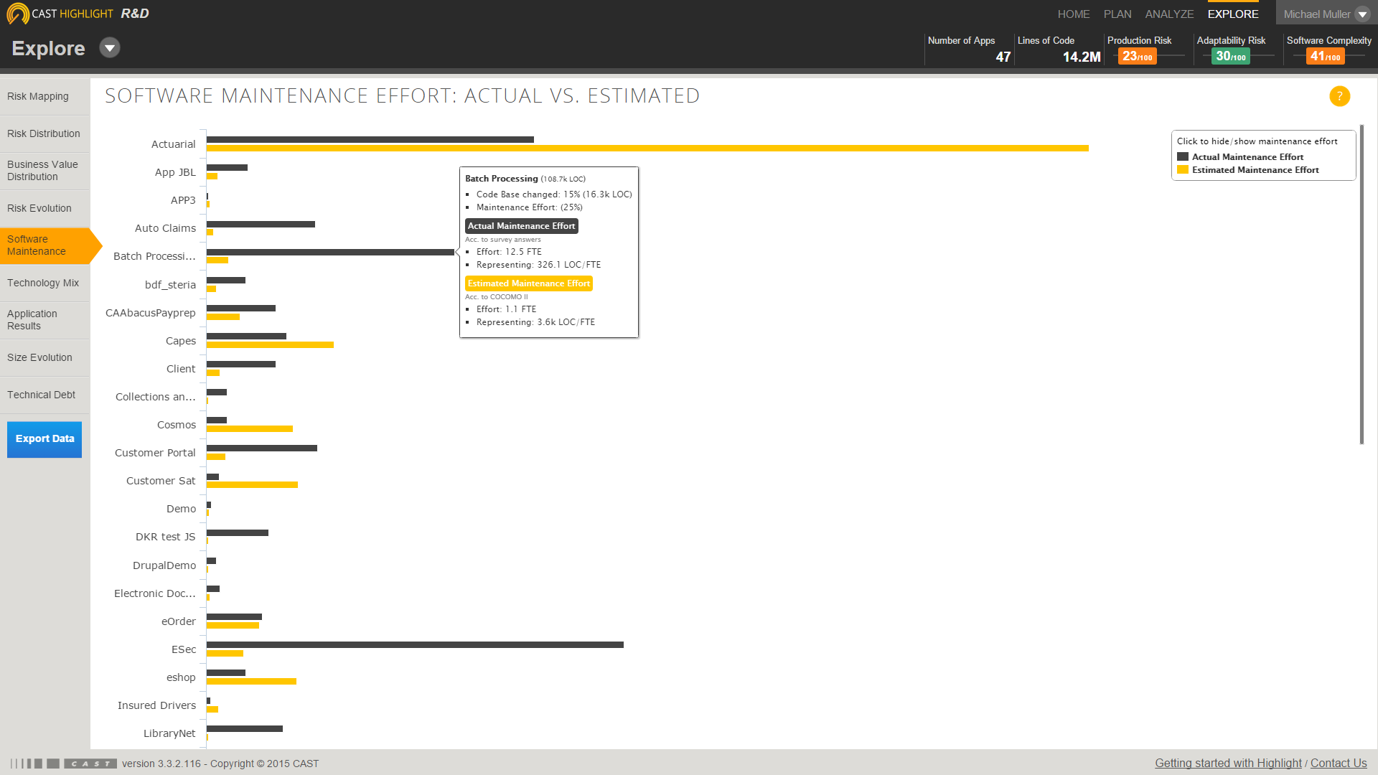
Software Maintenance Estimates
Actual Maintenance Effort (in FTE)
= (% of Development Effort spent on Maintenance) * (total FTE that worked on code)
Estimated Maintenance Effort (in FTE)
Computed by Highlight using COCOMO II model
Number of FTE to maintain the application in good conditions

Slide 50
Software Maintenance Estimates
Based on COCOMO II model
Constructive Cost Model, developed by M. Boehm (revised in 1995)
31 parameters required to compute an estimate of Software Maintenance efforts, expressed in FTE
11 of these parameters are collected with Highlight through:
Code analysis
Application Owner Surveys
Other parameters use the nominal value proposed by COCOMO

Slide 51


Software Maintenance Estimates
COCOMO drivers from Highlight
[Code Analysis] Code Base Size
[Code Analysis] Software Agility
[Code Analysis] Software Elegance
[Business Impact survey] Application failure leads to disruption
[Business Impact survey] Application failure leads to revenue loss
[Business Impact survey] Application failure impacts company’s image
[Business Impact survey] Application failure impacts customer confidence
[Software Maintenance survey] Application Type
[Software Maintenance survey] CMMi level
[Software Maintenance survey] Development Team’s skill level
[Software Maintenance survey] Annual staff turnover
[Software Maintenance survey] Maintenance Change Factor – Default: 15%

Slide 52
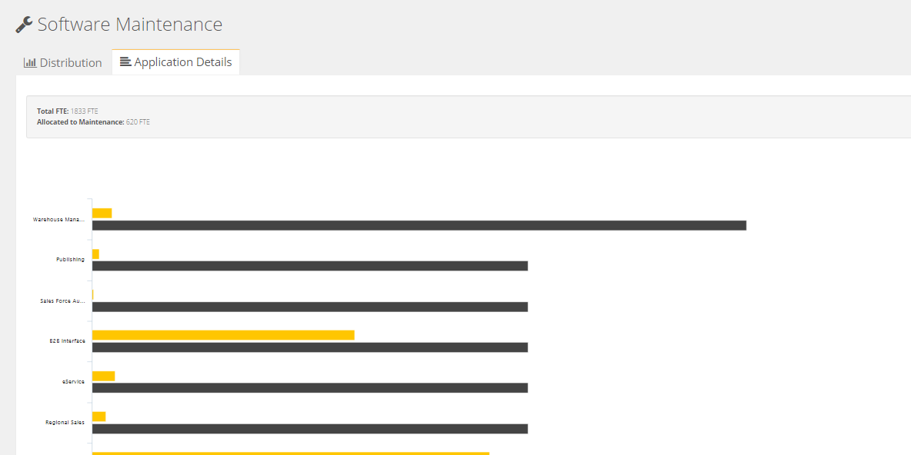
Software Maintenance Estimates

Slide 53
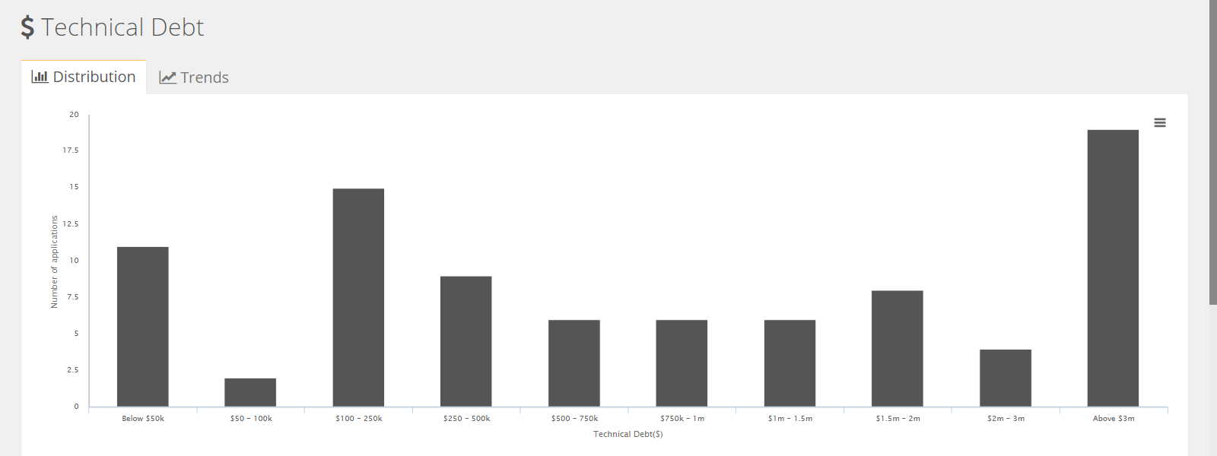
Technical Debt Estimates
Technical Debt represents the effort required to fix problems that remain in the code when an application is released.

Slide 54

Technical Debt Estimates
Technical Debt Estimates rely on Software Quality Measures collected through Appmarq, a CAST repository made of +1900 applications across 300 organizations (representing 2 billion LOC)
Appmarq Stats
for each technology
Highlight scores
Health Factor | Quartile
Resiliency | 3.0
Agility | 2.0
Elegance | 1.0
Quartile | $ / Loc
1.0 | $1.12
Median | $1.88
3.0 | $2.75
HL Model
Adjustment
Eg: COBOL

Slide 55
Technical Debt Estimates
Technical Debt Model Adjustment
Eg: a 50kloc COBOL application
Highlight Adjusted Technical Debt (2nd Quartile)
$1.88 / LOC
Alarms | Quartile
Resiliency | 3.0
Agility | 2.0
Elegance | 1.0
$94,000

Slide 56
Technical Debt Estimates
Adjusted Technical Debt $ / Loc for Highlight
Quartile | Min | Lower | Median | Upper | Max
SAP/Abap | $0.03 | $1.09 | $1.61 | $1.77 | $3.66
C | $0.04 | $1.20 | $2.10 | $2.94 | $15.22
COBOL | $0.02 | $1.13 | $1.88 | $2.75 | $8.80
C++ | $0.55 | $1.98 | $3.54 | $5.79 | $20.76
.Net | $0.05 | $2.54 | $3.49 | $4.90 | $13.78
Java | $0.02 | $3.71 | $5.89 | $7.86 | $20.00
SQL | $1.89 | $2.65 | $2.86 | $3.73 | $4.43
VB/VB.Net | $0.05 | $2.54 | $3.49 | $4.90 | $13.78
Eg:
Java 50 KLOC app.
Highlight Quartile: 1.0
Tech. Debt ~ $185,500K
(3.71 * 50000)

